Slide 1
I Ain’t Gonna Paint no More

Slide 2
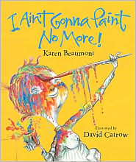
I AIN’GONNA PAINT NO MORE.
ILLUSTRATED BY DAVID CATROW.

Slide 4
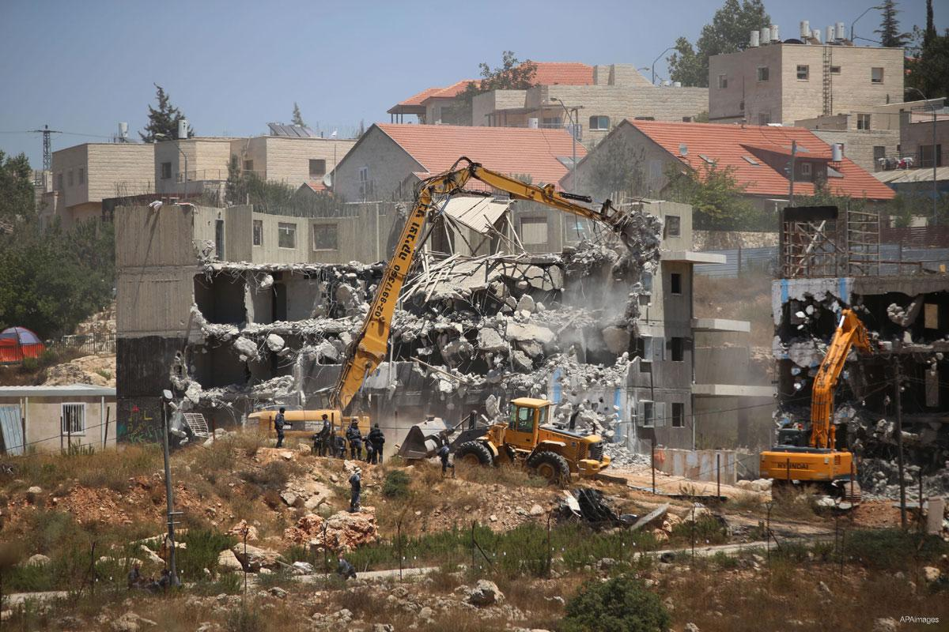

Slide 5
