Slide 1
Where the wild things are
By Maurice sendak presentation by Owen k

Slide 2
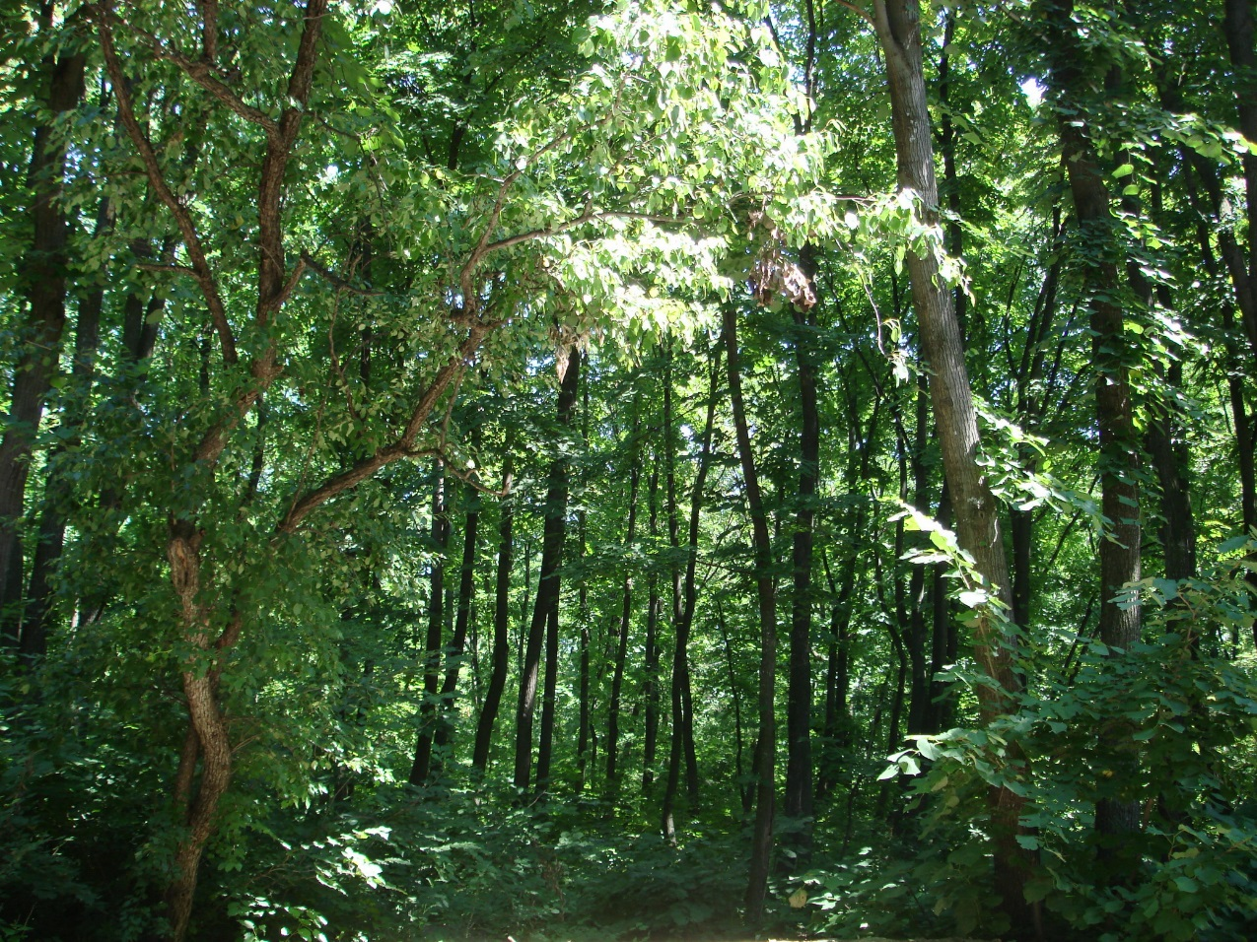
Have you ever read Where The Wild Things Are? If you have not you will like it. It is about this boy named Max. He imagens that his room is a forest.

Slide 3
My favorite part is when maxes room turns into a forest. My other favorite part is when he meets the wild things.

Slide 4
I would give it a five star rating

